Slide 1
Software Quality Assurance and Testing Technology
2nd Semester, Spring 2022
Haiming Liu
School of Software Engineering
Beijing Jiaotong University

Slide 2
16 Weeks Plan
Week 1: The basic concepts and theories of testing
Week 2-3: Principles of Testing
Week 4: Testing the specification
Week 5-6: Black Box Testing
Week 7-9: White Box Testing
Week 10: Integration Testing and System Testing
Week 11: Usability Testing and Accessibility Testing
Week 12: Security Testing
Week 13: Mutation Testing
Week 14: Software Quality
Week 15: Review I
Week 16: Review II

Slide 3
What is Testing
Black-box testing
Code
White-box testing
Gray-Box testing
Testing methods
Static testing
Run
Dynamic testing

Slide 4
Black-box Testing
Obviously, we need something that defines the software--- i.e.
requirements document or specification document.
Requirements
Output
B
Running SW
Given
Input A
We must be able to specify what should be produced as output B, given input A.
Events
We do NOT need to know HOW output B is produced from input A.

Slide 5
Black-box Testing
Random Testing
Equivalence Partitioning
Boundary Value Analysis

Slide 6

Black-box Testing
Test-to-pass and Test-to-fail
Test-to-pass:
assures that the software minimally works,
does not push the capabilities of the software,
applies simple and straightforward test cases,
does not try to “break” the program.
Test-to-fail:
designing and running test cases with the sole purpose of breaking the software.
strategically chosen test cases to probe for common weaknesses in the software.

Slide 7
Black-box Testing
Test Data and Test Cases
Test data: Inputs which have been devised to test the system.
Test cases: Inputs to test the system and the predicted outputs from these inputs if the system operates according to its specification.

Slide 8
Black-box Testing
Input causing anomalous behavior
Input test data
I
System
Output which reveal the presence of defects
Output test results
O

Slide 9
Black-box Testing
Obviously, we need something that defines the software--- i.e.
requirements document or specification document.
We must be able to specify what should be produced as output B, given input A.
We do NOT need to know HOW output B is produced from input A.
Although we can’t look at code, we may ask the programmers questions about numeric limits, internal quirks of the software etc. (More on this shortly.)

Slide 10
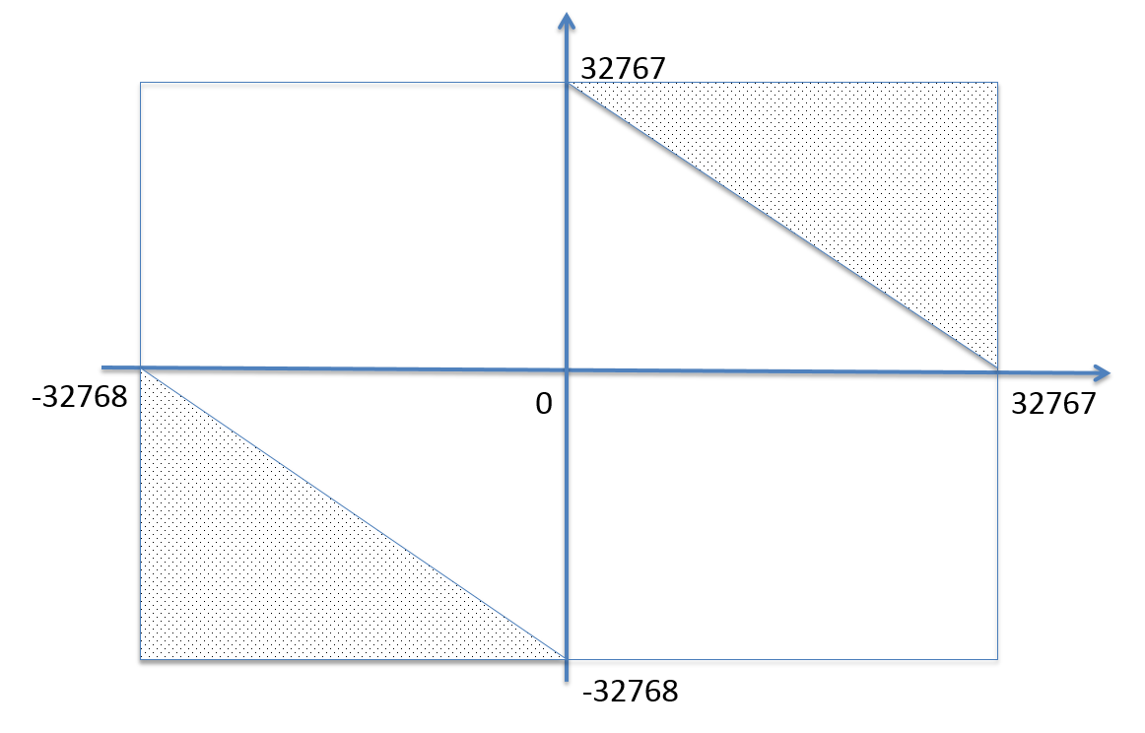
Random Testing(RT)
Test cases are generated purely at random
Input domain must be known
Pick random points within input domain
Automation
int Add(const int &a, const int &b)
{
return a+b;
}
16 bit

Slide 11
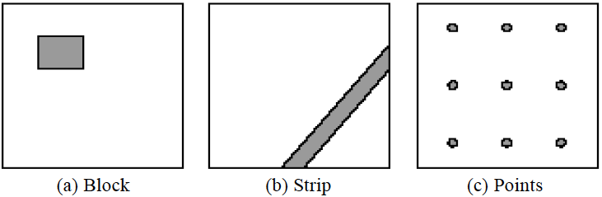
Random Testing
Typical patterns of failure-causing regions
A passed test, nearby tests may be passed
A failed test, nearby tests may be failed
So, select test cases far away from others …

Slide 12
Adaptive Random Testing(ART)
Random Testing
选择测试用例1，若未出错，定义距离d1
​ 寻找下一条测试用例2时，到离测试用例1>d1的地方
​ 若测试用例2依然没有发生错误，定义距离d2
​ 寻找下一条测试用例3时，到离测试用例1 2 >d2的地方
直至发现错误。

Slide 13
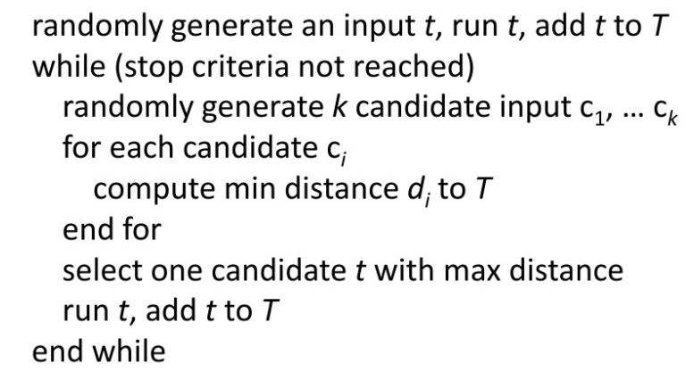
FSCS-ART algorithm
Problem in ART
Distance
Sampling

Slide 14
Anti-Random Testing
Hamming Distance
x ⊕ y= z
10101 ⊕ 00110 = ?
10101 ⊕ 00110 = 3
10101
00110
test1 = 00000000
test2 = 11111111
test3 = 00001111
test4 = 11110000
THM(test2) = 8
THM(test3) = 8
THM(test4) = 16

Slide 15
Define equivalence partitions - or classes
Equivalence partitioning helps us cut down the number of test cases without adding a great deal of risk.
Normally we look at two areas for testing:
- Data
- Logic flow
There are many guidelines for picking equivalence partitions.
Note: These are guidelines, not hard and fast rules.

Slide 16
Data Testing GUIDELINES FOR CHOOSING EQUIVALENCE CLASSES
Identify boundary conditions - data that is at the edge of the planned operational limits of the software.
For the boundaries, partition input into
- Valid data inside the boundary.
- Data just on the boundary (which may be valid or invalid).
- Invalid data just outside the boundary limits.
Boundary conditions should be identified in the requirements or the specifications.

Slide 17
Equivalence Partitioning
Idea is to partition the input space into a number of equivalence classes such that one could expect, based on the specification, that every element of a given class would be ‘‘handled’’ (i.e., mapped to
an output) in the same manner
(either correctly or incorrectly),
thus reducing the total number of test cases that must be developed.
Two types of classes are identified:
valid (corresponding to inputs deemed valid from the specification)
invalid (corresponding to inputs deemed erroneous from the specification)

Slide 18
Equivalence Partitioning
Divide all possible inputs into classes (partitions) such that : There is a finite number of input equivalence classes
You may reasonably assume that
The program behaves analogously for inputs in the same class
One test with a representative value from a class is sufficient
If the representative detects a fault, then other class members would detect the same fault
i₁
i₄
i₂
i₃
all inputs

Slide 19
Equivalence Classes
Valid data
User supplied commands.
Responses to system prompts.
File names.
Computational data:
Physical parameters,
Bounding values,
Initiation values.
Output data formatting commands.
Responses to error messages.
Graphical data.
Invalid data
Data outside bounds of the program.
Physically impossible data.
Proper value supplied in wrong place.

Slide 20
Equivalence Classes Strategy
Identify input equivalence classes
Based on conditions on inputs/outputs in specification/description: Both valid and invalid input equivalence classes
Based on heuristics and experience :
“input x in [1..10]”
→ classes : x < 1, 1 ≤ x ≤ 10, x > 10
“enumeration A, B, C“
→ classes : A, B, C, not{A,B,C,}
"input integer
→ classes : n not an integer, n < min, min ≤ n < 0, 0 ≤ n ≤ max, n > max

Slide 21
Equivalence Partitioning Example 1
Partition system inputs into groups (partitions) that should cause
equivalent behaviour, include both valid and invalid inputs.
If input is a 5-digit integer between 10,000 and 99,999,
Equivalence partitions are:
< 10,000 10,000 - 99,999 > 99,999

Slide 22
Equivalence Partitioning Example 2
Identify (multiple sets of disjoint) equivalence classes for the following program specification fragment.
Individual Income Tax Specification:
If gross pay is no more than ￥36,000, the tax is 3%.
If gross pay is more than ￥36,000, but no more than ￥144,000, the tax is 10%.
If gross pay is more than ￥ 144,000, but no more than ￥300,000, the tax is 20%.
If gross pay is more than ￥ 300,000, but no more than ￥420,000, the tax is 25%.

Slide 23
Equivalence Partitioning
1. If input is a range, one valid and two invalid equivalence classes:
less than range
in range
greater than range
2. If input is a specific value, one valid and two invalid equivalence classes:
less than value
value
greater than value
3. If input is a set of related values, one valid and one invalid class:
not member of set
member of set
4. If input is Boolean, one valid and one invalid class:
nonBoolean
Boolean

Slide 24
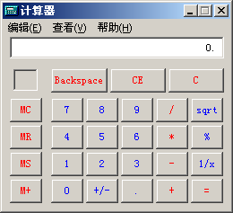
Equivalence Partitioning Example 3
Test for addition operation of MS calculator.

Slide 25
Equivalence Partitioning Example 3
Notes:
加法呢 用例编号，所属等价类（描述），X , Y， output
Equivalence Class No
Description of the class
Type（Valid or in Valid）
Test case
No.
Test data
Expected outcome
Equivalence Classes Covered
第1类：整数（只考虑这个是不完善的），只考虑范围，没有考虑类型
第二类：小数
第三类：阴性
类别4：无效输入
5 相乘之后溢出 -32768 32767 16bit
Class 1: Integer
Class 2: Decimal fraction
Class 3: Negative？
Class 4: Invalid input
Class 5: Overflow

Slide 26
Equivalence Partitioning
Test for Personal name（上户口）

Slide 27

Equivalence Partitioning
Test for ID number（身份证）

Slide 28
To be continued… See you next week

